Slide 1

COVID-19 Transmission Network: Verification and Validation of Transmission Stories
CSC8550 Advanced Algorithms Project Presentation
Zafar Iqbal, Javad Rafiei, & Mokter Hossain

Slide 2
COVID-19 Transmission Network
Presentation Outline:
Introduction
Objective
Datasets (Manual and Automated)
Sequenced data
Problem formulation
Algorithms Pseudo code
Visualizations
Future Works
Reference
Q&A
Zafar Iqbal, Javad Rafiei, & Mokter Hossain

Slide 3
COVID-19 Transmission Network
Introduction
Since mid-December of 2019, coronavirus disease 2019 (COVID-19) has been spreading from Wuhan, China.
As of today the COVID-19 has outbroken in about 200 countries of the world.
About 2.7M Cases with 200K death.

Slide 4
COVID-19 Transmission Network
Objective
To find and validate the sequences and Stories behind how the Novel COVID-19 Transmission Outbreak
We search to find the two major facts:
Sequence of transmission; and
Stories behind the transmission

Slide 5
Our Manually Extracted Dataset
We extracted about 100 records from reliable and trusted sources
wikipedia.org, abcnews.com, cnn.com, nbcnews.com,
cdc.gov, gisaid.org, etc.
ID | Source | Destination | Date
1 | Wuhan, China | Huanan, China | 29-Dec-19
2 | Wuhan, China | Anyang, China | 10-Jan-20
3 | Wuhan, China | Bangkok, Thailand | 13-Jan-20
4 | Wuhan, China | Tokyo, Japan | 16-Jan-20
5 | Wuhan, China | Zhejiang, China | 19-Jan-20
6 | Wuhan, China | Zhejiang, China | 19-Jan-20
7 | Wuhan, China | Tokyo, Japan | 20-Jan-20
8 | Wuhan, China | Bangkok, Thailand | 20-Jan-20
9 | Wuhan, China | Seoul, South Korea | 20-Jan-20
10 | Wuhan, China | Snohomish, WA | 20-Jan-20

Slide 6
Some Transmission Stories of COVID-19
Wuhan, China on Dec 29 , 2019.
Outside of Wuhan, Jan 10, 2020
Thailand on Jan 13, 2020;
Japan Jan 16, 2020;
South Korea on Jan 20, 2020
USA, WA State on Jan 20, 2020; CA on Jan 26, 2020; GA on March 2, 2020
France on Jan 24, 2020;
Spain, Sweden, Russia, Jan 31, 2020
Jan. 30, 2020: WHO declares global health emergency
On Jan 12, WHO named coronavirus as the 2019-nCoV
Later, on Feb 11, 2020 the WHO renamed it as COVID-19.

Slide 7
The Automated Dataset
We extracted about 800 transmission records from the gisaid.org
https://www.gisaid.org/epiflu-applications/next-hcov-19-app/

Slide 8
GISAID CoV-19 sequenced data and Problem formulation

Slide 9
Genetic sequences
Genetic sequence data from pathogens presents a novel means to investigate the spread of infectious disease between infected hosts.
The objective is to recover the epidemic transmission tree, which identifies who infected whom.
On the basis of difference between sequences and other factors( recombination and convergent evolution), the transmission tree could be predicted.

Slide 10
Coronaviruses have a genome made of RNA.
Viruses with RNA genomes have an essential gene called the RNA-dependent RNA polymerase (RdRp), which is highly conserved, meaning that there are few changes in the gene from one RNA virus to another. This makes the gene useful for measuring the evolutionary distance and relatedness of one RNA virus to another.
RNA viruses have high mutation rates that result in several slightly different versions of the viral genome being made each time the viral genome is replicated.

Slide 11
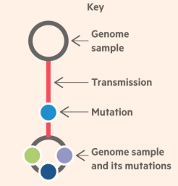
Virus mutation
A virus spreads by rapidly replicating many times within its host.
Transmission to a new hosts also occurs by the replication
The rapid replication results in copying mistakes.
Miner changes in their genetic code. (mutations)
Coronavirus mutates almost twice a month.

Slide 12
Scientists studying mutations in coronavirus have decoded more than 10,000 different genomes of the deadly pathogen.
Creates a comprehensive map that will be crucial to controlling the pandemic and developing medicines to treat it.

Slide 13
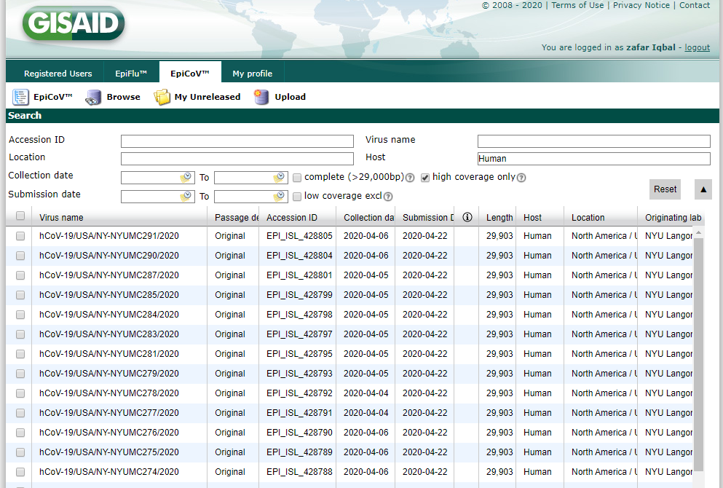
GISAID Dataset

Slide 14
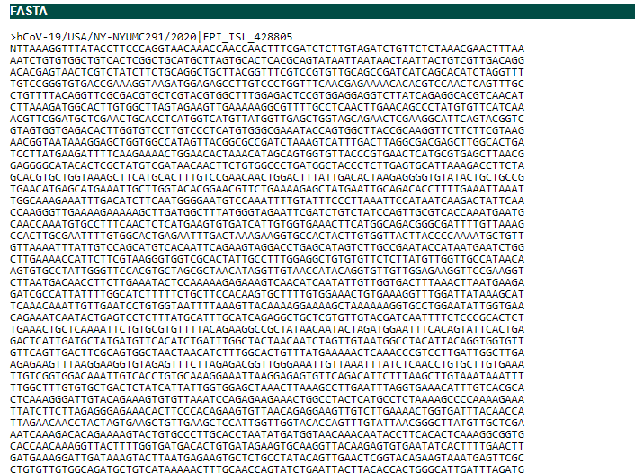
Genome sequence

Slide 15
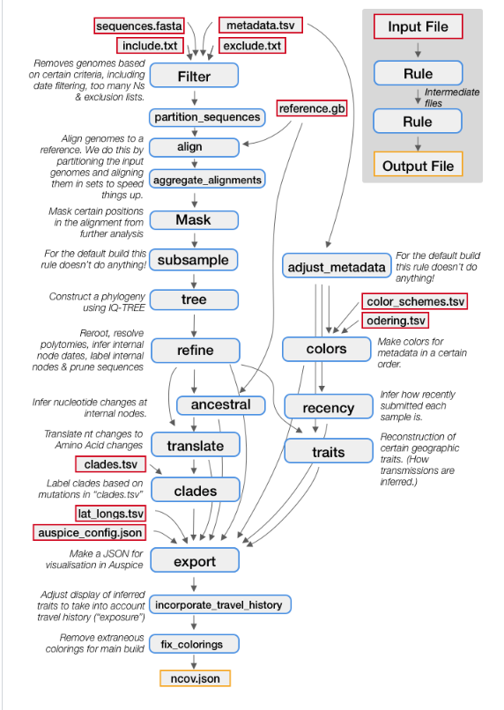
Nextstrain’s Augur
Bioinformatics' toolkit used to analyze different pathogens (viruses).
The data undergoes different steps:
Filter the sequences
Align the sequences
Construct the phylogeny (tree)
Get a Time-Resolved Tree
Identify Amino-Acid Mutations
Json file containing hierarchal information about transmission.
Notes:
Nextstrain is an open-source project to harness the scientific and public health potential of pathogen genome data
Provides powerful analytic and visualization tools for genome sequences
Converted to csv containing three columns
Manual data vs gisaid data
Compare both the graphs. And try to validate

Slide 16
Sub-graph isomorphism problem
The subgraph isomorphism problem is a computational task in which two graphs G and H are given as input, and one must determine whether G contains a subgraph that is isomorphic to H.
Isomorphism is an exact graph matching: if used as a distance for comparison, it gives a binary outcome.
Notes:
The case of exact graph matching is known as the graph isomorphism problem.^{[1]} The problem of exact matching of a graph to a part of another graph is called subgraph isomorphism problem.

Slide 17
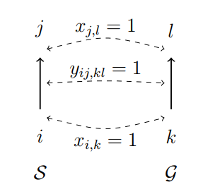

Problem formulation (ILP)
Given:
$$S=\left(V_{s},E_{s}\right), G=\left(V_{G},E_{G}\right)$$
Variables:
$x_{i,k}∈\left\{0,1\right\} ∀ⅈ∈V_{s},k∈V_{ς}$
$y_{ij,kl}∈\left\{0,1\right\} ∀ⅈj∈E_{s},∀k∈E_{ς}$
$c={\left\{0,1\right\}}^{n}$
$C_{v}:V_{s} X V_{ς}→R^{+}$
$C_{E}:V_{G} X E_{ς}→R^{+}$
Notes:
An edge e originating from I and targeting to j can be denoted as ij.
Cost:

Slide 18
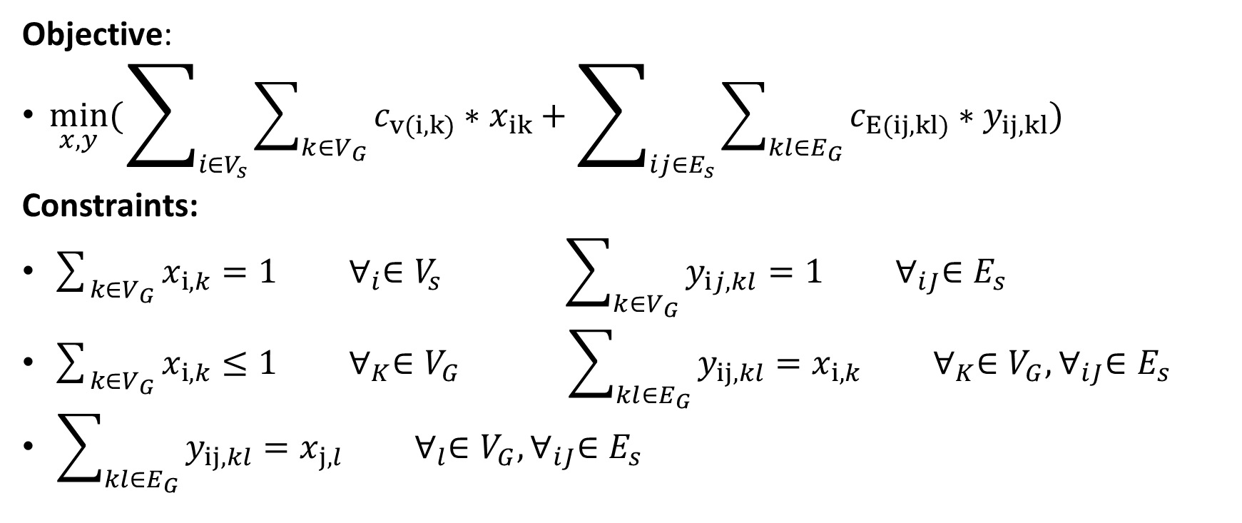
Objective:
$\min_{x,y}(\sum_{i∈V_{s}}{\sum_{k∈V_{G}}{c_{v(i,k)}∗x_{ik}}}+\sum_{ij∈E_{s}}{\sum_{kl∈E_{G}}{c_{E(ij,kl)}∗y_{ij, kl}}})$
Constraints:
$\sum_{k∈V_{G}}{x_{i,k}}=1 ∀_{i}∈V_{s} \sum_{k∈V_{G}}{y_{ij,kl}}=1 ∀_{iJ}∈E_{s}$
$\sum_{k∈V_{G}}{x_{i,k}}≤1 ∀_{K}∈V_{G} \sum_{kl∈E_{G}}{y_{ij,kl}}=x_{i,k} ∀_{K}∈V_{G}, ∀_{iJ}∈E_{s}$
$\sum_{kl∈E_{G}}{y_{ij,kl}}=x_{j,l} ∀_{l}∈V_{G}, ∀_{iJ}∈E_{s}$
Notes:
Objective: the global cost for matching S to a subgraph of G, which is the sum of the costs for matching vertices and edges, should be minimized
Every vertex of S must be matched to a unique vertex of G
Every edge of S must be matched to a unique edge of G
Every vertex in G must be matched to at most one vertex of S
If two vertices are matched together, an edge originating the vertex of S must be matched with an edge originating the vertex of G
If two vertices are matched together, an edge targeting the vertex of S must be matched with an edge targeting the vertex of G:

Slide 19
Known Node-Correspondence (KNC)–the two networks have the same node set (or atleast a common subset), and the pairwise correspondence between nodes is known. Thus, typically, only graphs of the same size and coming from the same application domain can be compared.
Unknown Node-Correspondence (UNC)–ideally any pair of graphs (even with different sizes, densities, or coming from different application fields) can be compared:
Notes:
For example, imagine that one wants to compare the European air transportation networks of the airlines A
and B. The node sets (i.e., the European airports) are the same, thus a KNC method can be applied to quantify to
what extent the two sets of edges are similar, i.e., to what extent the two airlines offer the same set of flights

Slide 20
Algorithms and Experiments

Slide 21
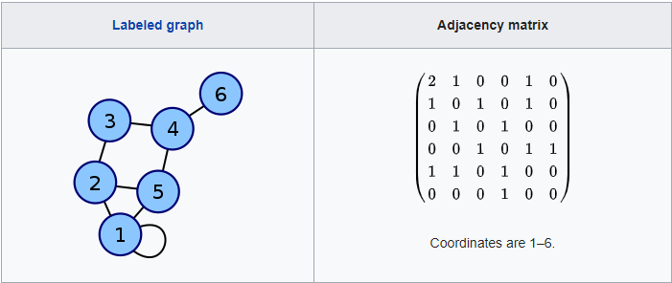
Adjacency matrix
An adjacency matrix is a square matrix used to represent a finite graph.
The elements of the matrix indicate whether pairs of vertices are adjacent or not in the graph.

Slide 22

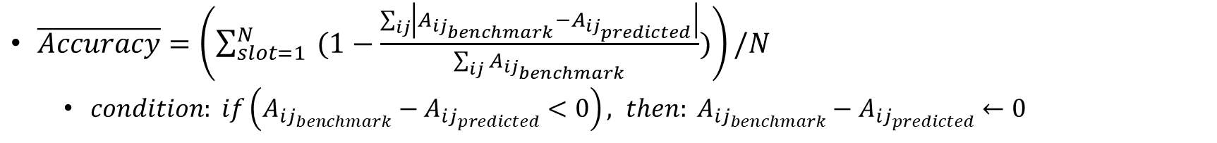
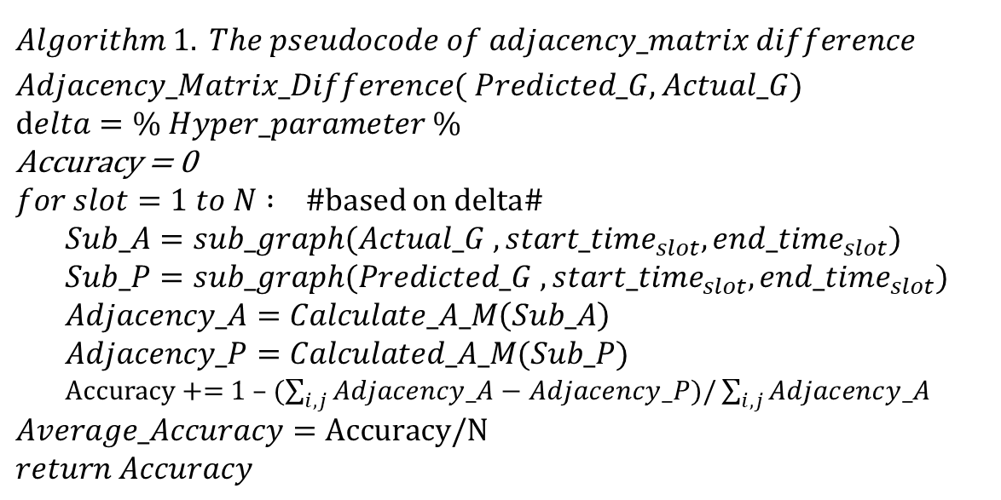
$$Algorithm 1. The pseudocode of adjacency_matrix difference$$
$Adjacency_Matrix_Difference( Predicted_G, Actual_G)$
$$delta=\% Hyper_parameter \%$$
$$\text{Accuracy}\text{ = 0}$$
$for slot=1 to N : \#$based on delta#
$Sub_A=sub_graph(Actual_G , {start_time}_{slot}, {end_time}_{slot})$
$$Sub_P=sub_graph(Predicted_G , {start_time}_{slot}, {end_time}_{slot})$$
$Adjacency_A=Calculate_A_M\left(Sub_A\right)$
$$Adjacency_P=Calculated_A_M(Sub_P)$$
Accuracy += 1 – ($\sum_{i,j}{Adjacency_A−Adjacency_P})/\sum_{i,j}{Adjacency_A}$
$$Average_Accuracy=\text{Accuracy}\text{/}\text{N}$$
$$return Accuracy$$
. . . .
slot1
slot2
slotN
$$δ$$
Actual Trans
Predicted Trans
Time
$\overline{Accuracy}=\left(\sum_{slot=1}^{N}{ (1−\frac{\sum_{ij}{\left|A_{{ij}_{benchmark}}−A_{{ij}_{predicted}}\right|}}{\sum_{ij}{A_{{ij}_{benchmark}}}})}\right)/N$
$condition: if\left(A_{{ij}_{benchmark}}−A_{{ij}_{predicted}}<0\right), then: A_{{ij}_{benchmark}}−A_{{ij}_{predicted}}←0$

Slide 23
Method 1

Slide 24

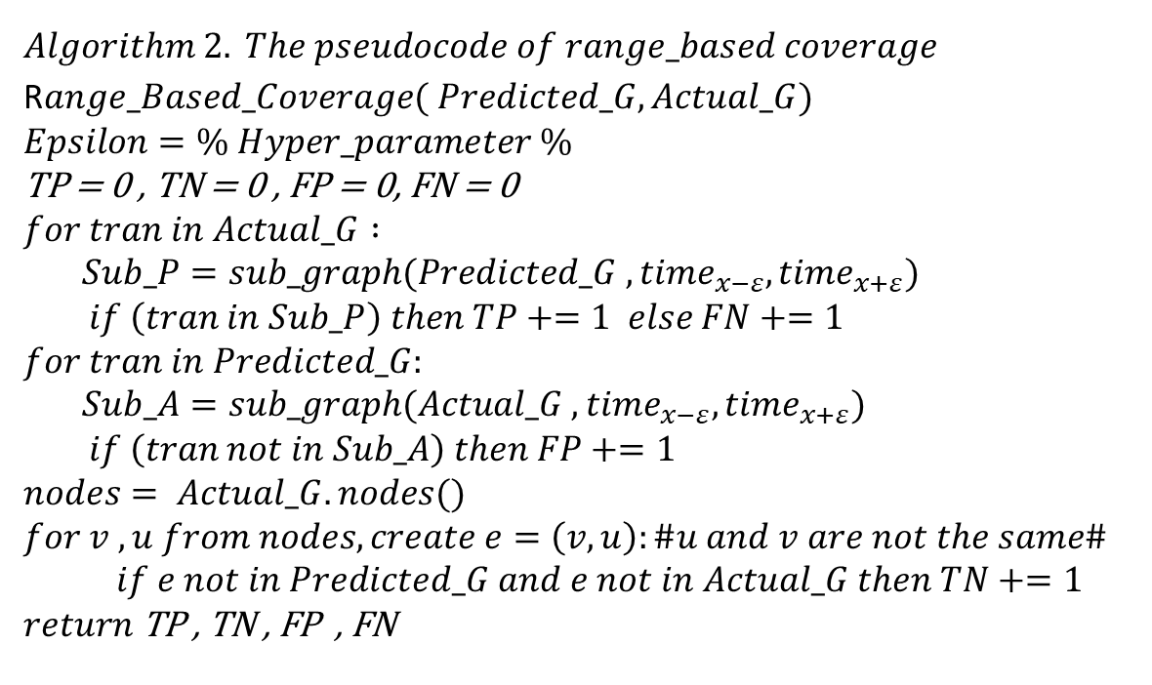

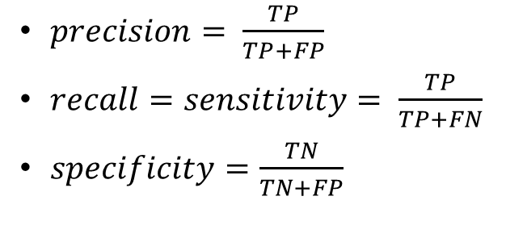



$$Algorithm 2. The pseudocode of range_based coverage$$
R$ange_Based_Coverage( Predicted_G, Actual_G)$
$$Epsilon=\% Hyper_parameter \%$$
$$\text{TP}\text{ = 0}\text{ , }\text{TN}\text{ = 0 , }\text{FP}\text{ = 0, }\text{FN}\text{ = 0 }$$
$$for tran in Actual_G :$$
$Sub_P=sub_graph(Predicted_G , {time}_{x−ε}, {time}_{x+ε})$
$if \left(tran in Sub_P\right) then TP+=1 else FN+=1$
$$for tran in Predicted_G:$$
$Sub_A=sub_graph(Actual_G , {time}_{x−ε}, {time}_{x+ε})$
$if \left(tran not in Sub_A\right) then FP+=1$
$$nodes= Actual_G.nodes()$$
$$for v , u from nodes, create e=\left(v,u\right):\#u and v are not the same\#$$
$if e not in Predicted_G and e not in Actual_G then TN+=1$
$$return \text{TP}\text{ , }\text{TN}\text{ , }\text{FP}\text{ , }\text{FN}$$
$$x−ε$$
$$x$$
$$x+ε$$
$$ε$$
$$ε$$
Actual Trans
Predicted Trans
Time
$precision= \frac{TP}{TP+FP}$
$recall=sensitivity= \frac{TP}{TP+FN}$
$specificity=\frac{TN}{TN+FP}$
Predicted
 | Positive | Negative
Positive | TP | FN
Negative | FP | TN
Actual

Slide 25
Method 2

Slide 26
Source code on GitHub: https://github.com/jasl1/Covid-19-transmission-network
Visualization Results for weekly snapshots of predicated and Actual Graphs

Slide 27
Future Work
Improving benchmark dataset by crawling news and scientific papers
Using NLP-based techniques
Designing more complicated algorithms
Such as DeltaCon and CutDistance
Comparing our approach with other state-of-the-art methods
Using different measurements
Exploring other epidemical repositories to find more predictions
Based on different alignment algorithms

Slide 28
References:
https://www.sciencedirect.com/science/article/pii/
https://en.wikipedia.org/wiki/Coronavirus_disease_2019
https://abcnews.go.com/Health/timeline-coronavirus-started/story?id=69435165
https://en.wikipedia.org/wiki/2019%E2%80%9320_coronavirus_pandemic_by_country_and_territory
https://www.npr.org/sections/goatsandsoda/2020/03/30/822491838/coronavirus-world-map-tracking-the-spread-of-the-outbreak

Slide 29

Thank you!

